Slide 1
Communication: The Key to Health Care
Rachel Jones, VALOR-RN Student
Radford University

Slide 2
Who am I
Senior nursing student at Radford University
4.0 GPA
Goals:
Work in critical care
Go back to graduate school
Become a nurse anesthetist
Live happily ever after…
Founded 1966
Ranked in top 4 percent of all public nursing schools
Ranked in the top 50 nursing schools in the region
97% NCLEX first time pass rate

Slide 3
What’s a VALOR?
Rising senior in a nursing program
Selected based on GPA, resume, recommendation, and clinical experience
Interviewed and hired as a VALOR RN Student Tech
Complete 400 hours over the summer
Work on the assigned floor under RN, BSN
Rotate among other units and specialty clinics
Determine improvement project with nurse manager and nurse educator
Complete project, write paper with literature review, and present

Slide 4
Communication Cards
Situation: Patients cannot always communicate effectively after anesthesia, while in pain, or when drowsy. Some patients also have dementia, creating a barrier between communication. Nurses also try not to disturb other patients in the two and four-man rooms at night when trying to communicate with other patients sharing the room.
Background: There is often a barrier of communication between the nurse and patient. This barrier is sometimes due to the patient’s post-operative status and the lasting effects of anesthesia. Other times where communication can be misconstrued can be related to patients who are in so much pain that they cannot express what they need. There are other times when the patient is simply drowsy, whether it be from medication or lack of rest, and times where the nurse is trying not to disturb the other veterans in the room; however, patients can still have unmet needs during this time, and nurses need a quick and easy way to check for these needs.

Slide 5
Assessment: 2F does not currently have a flashcard method of patient communication in place. There is a need for a laminated, ring-bound flashcard set of common requests that the nurse can use to help understand and ultimately meet the needs of the patient.
Recommendation: Provide nurses with a ring-bound laminated flashcard set of common requests/needs to facilitate easier communication with patients who have something impeding their communication.

Slide 6
How can I help you?

Slide 7
NURSE

Slide 8
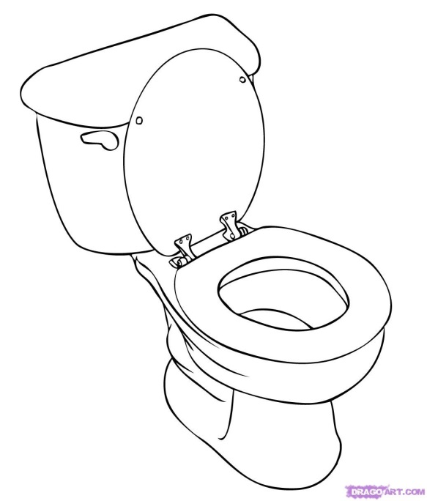
Bathroom

Slide 9
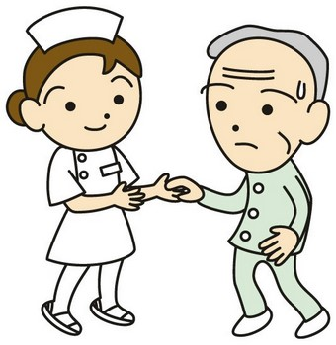
Go Walk

Slide 10
BATH

Slide 11
WATER

Slide 12
BLANKET

Slide 13
TV ON/OFF

Slide 14
COLD

Slide 15
HUNGRY

Slide 16
HOT

Slide 17
TIRED

Slide 18
LIGHT ON/OFF

Slide 19
PHONE

Slide 20
HURT/PAIN

Slide 21
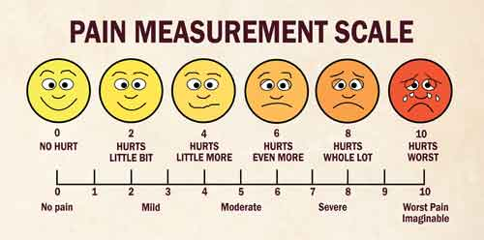

Slide 22
CHAIR

Slide 23
BED

Slide 24
CHAPLAIN

Slide 25
SMOKE

Slide 26
ALCOHOL

Slide 27
REMOTE

Slide 28
SOCKS ON/OFF

Slide 29
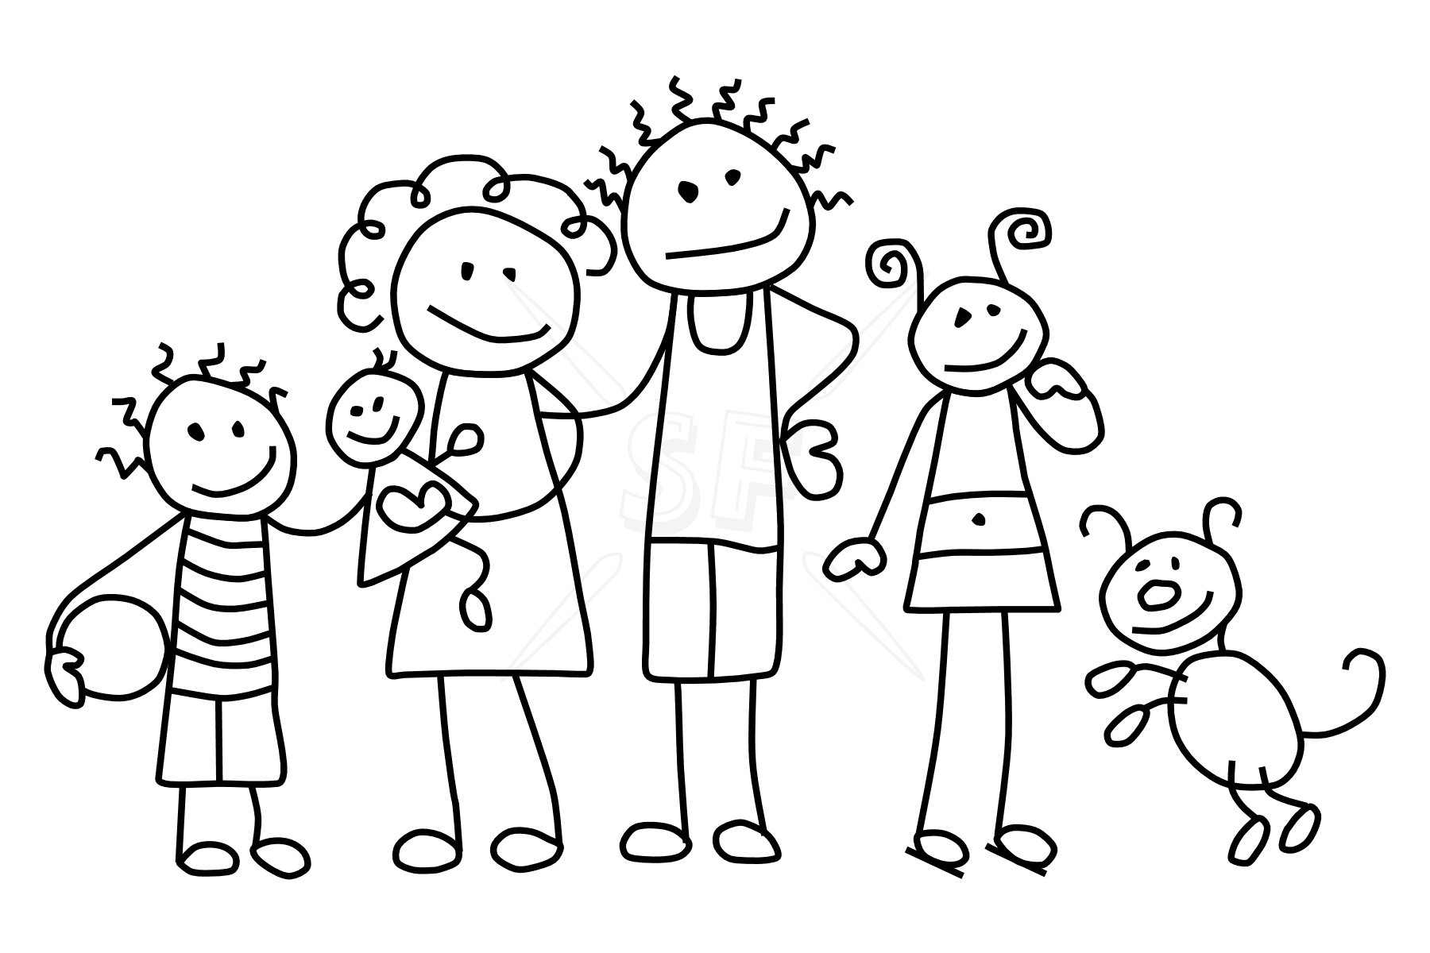
FAMILY MEMBER

Slide 30
CHEST PAIN

Slide 31
HEADACHE

Slide 32
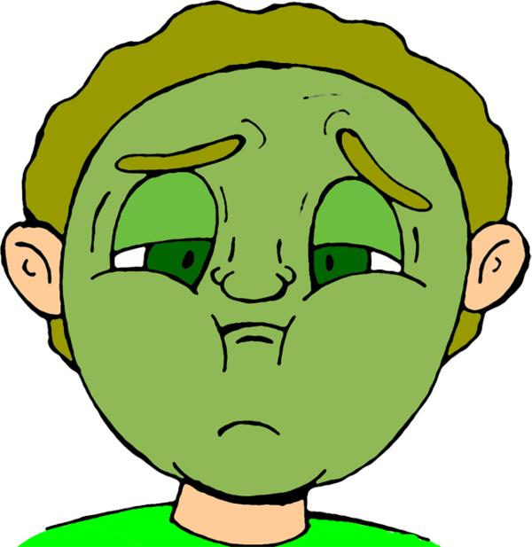
NAUSEA

Slide 33
DIZZY/LIGHTHEADED

Slide 34
Why Use Them…
Visual Aid
Simple
Colorful
Picture featured, with phrase
Low-cost
Better serve our vets ☺

Slide 35
References
Juvé-Udina, M.E., Pérez, E., Padrés, N., Samartino, M., García, M., Creus, M., Batllori., N. & Calvo, C. (2014). Basic nursing care: Retrospective evaluation of communication and psychosocial interventions documented by nurses in the acute care setting. Journal of nursing scholarship, 46(1), 65-72).
Keltner, N., Bostrom, C. & McGuinness, T. (2011). Nurse-patient communication. In D. Smith (Ed.) Psychiatric nursing (pp. 60-65). St. Louis, MO: Elsevier.

